Slide 1
Lecture 4: Block cipher，DES, AES, Modes of operation
Introduction to Computer Security

Slide 2
Acknowledgements and Reading
These slides are adapted from lecture slides by…
Lawrie Brown
Dan Boneh
and others
Reading: Chapters 3, 5, 6

Slide 3
Block ciphers: crypto work horse
n bits
n bits
E, D
PT Block
CT Block
Key
k bits
Canonical examples:
3DES: n= 64 bits, k = 168 bits
AES: n=128 bits, k = 128, 192, 256 bits

Slide 4
Block Ciphers Built by Iteration
key k
key expansion
k₁
k₂
k₃
k_{n}
m
R(k₁, ⋅)
R(k₂, ⋅)
R(k₃, ⋅)
R(k_{n}, ⋅)
c
R(k,m) is called a round function
for 3DES (n=48), for AES-128 (n=10)

Slide 5
Performance: Crypto++ 5.6.0 [ Wei Dai ]
AMD Opteron, 2.2 GHz ( Linux)
Cipher Block/key size Speed (MB/sec)
RC4 126
Salsa20/12 643
Sosemanuk 727
3DES 64/168 13
AES-128 128/128 109
stream
block

Slide 6
Design Principles
Confusion: break the dependence between input and output
Diffusion: one change in the plaintext spreads to the whole ciphertext

Slide 7
DES

Slide 8
The Data Encryption Standard (DES)
Early 1970s: Horst Feistel designs Lucifer at IBM
key-len = 128 bits ; block-len = 128 bits
1973: NBS asks for block cipher proposals. IBM submits variant of Lucifer.
1976: NBS adopts DES as a federal standard
key-len = 56 bits ; block-len = 64 bits
1997: DES broken by exhaustive search
2000: NIST adopts Rijndael as AES to replace DES
Widely deployed in banking (ACH) and commerce

Slide 9
DES: core idea – Feistel Network
Given functions f₁, …, f_{d}: {0,1}^{n} ⟶ {0,1}^{n}
Goal: build invertible function F: {0,1}^{2n} ⟶ {0,1}^{2n}
R₀
R₁
R₂
R_{d-1}
R_{d}
n-bits
f₁
f₂
⋯
f_{d}
L₀
L₁
L₂
L_{d-1}
L_{d}
n-bits
⊕
⊕
⊕
input
output
In symbols:

Slide 10
Feistel network is invertible
Claim: for all f₁, …, f_{d}: {0,1}^{n} ⟶ {0,1}^{n} , Feistel network F: {0,1}^{2n} ⟶ {0,1}^{2n} is invertible Proof: construct inverse
R_{i-1}
R_{i}
R_{i-1} = L_{i}
L_{i-1} = f_{i}(L_{i}) ⨁ R_{i}
inverse
f_{i}
L_{i-1}
L_{i}
⊕

Slide 11
Inversion in a picture
R_{i-1}
R_{i}
R_{i}
⊕
R_{i-1}
inverse
f_{i}
L_{i}
f_{i}
L_{i-1}
L_{i-1}
L_{i}
⊕

Slide 12
Decryption circuit
R_{d}
⊕
⊕
⊕
n-bits
R_{d-1}
R_{d-2}
R₁
R₀
⋯
f_{d}
f_{d-1}
f₁
L_{d}
L_{d-1}
L_{d-2}
L₁
L₀
n-bits
Inversion is basically the same circuit, with f₁, …, f_{d} applied in reverse order
General method for building invertible functions (block ciphers) from arbitrary functions.
Used in many block ciphers … but not AES

Slide 13
DES: 16 round Feistel network
f₁, …, f₁₆: {0,1}³² ⟶ {0,1}³² , f_{i}(x) = F( k_{i}, x )
k
key expansion
⋯
k₁
k₂
k₁₆
16 round Feistel network
IP
IP⁻¹
64 bits
64 bits
input
To invert, use keys in reverse order
output

Slide 14
Initial/Final Permutation
58 | 50 | 42 | 34 | 26 | 18 | 10 | 2
60 | 52 | 44 | 36 | 28 | 20 | 12 | 4
62 | 54 | 46 | 38 | 30 | 22 | 14 | 6
64 | 56 | 48 | 40 | 32 | 24 | 16 | 8
57 | 49 | 41 | 33 | 25 | 17 | 9 | 1
59 | 51 | 43 | 35 | 27 | 19 | 11 | 3
61 | 53 | 45 | 37 | 29 | 21 | 13 | 5
63 | 55 | 47 | 39 | 31 | 23 | 15 | 7
40 | 8 | 48 | 16 | 56 | 24 | 64 | 32
39 | 7 | 47 | 15 | 55 | 23 | 63 | 31
38 | 6 | 46 | 14 | 54 | 22 | 62 | 30
37 | 5 | 45 | 13 | 53 | 21 | 61 | 29
36 | 4 | 44 | 12 | 52 | 20 | 60 | 28
35 | 3 | 43 | 11 | 51 | 19 | 59 | 27
34 | 2 | 42 | 10 | 50 | 18 | 58 | 26
33 | 1 | 41 | 9 | 49 | 17 | 57 | 25
IP: 表1
IP⁻¹ 表2

Slide 15
58 | 50 | 42 | 34 | 26 | 18 | 10 | 2
60 | 52 | 44 | 36 | 28 | 20 | 12 | 4
62 | 54 | 46 | 38 | 30 | 22 | 14 | 6
64 | 56 | 48 | 40 | 32 | 24 | 16 | 8
57 | 49 | 41 | 33 | 25 | 17 | 9 | 1
59 | 51 | 43 | 35 | 27 | 19 | 11 | 3
61 | 53 | 45 | 37 | 29 | 21 | 13 | 5
63 | 55 | 47 | 39 | 31 | 23 | 15 | 7
M₁ M₂ M₃ M₄ M₅ M₆ M₇ M₈
M₉ M₁₀ M₁₁ M₁₂ M₁₃ M₁₄ M₁₅ M₁₆
M₁₇ M₁₈ M₁₉ M₂₀ M₂₁ M₂₂ M₂₃ M₂₄
M₂₅ M₂₆ M₂₇ M₂₈ M₂₉ M₃₀ M₃₁ M₃₂
M₃₃ M₃₄ M₃₅ M₃₆ M₃₇ M₃₈ M₃₉ M₄₀
M₄₁ M₄₂ M₄₃ M₄₄ M₄₅ M₄₆ M₄₇ M₄₈
M₄₉ M₅₀ M₅₁ M₅₂ M₅₃ M₅₄ M₅₅ M₅₆
M₅₇ M₅₈ M₅₉ M₆₀ M₆₁ M₆₂ M₆₃ M₆₄
IP
置换前
M₅₈ M₅₀ M₄₂ M₃₄ M₂₆ M₁₈ M₁₀ M₂
M₆₀ M₅₂ M₄₄ M₃₆ M₂₈ M₂₀ M₁₂ M₄
M₆₂ M₅₄ M₄₆ M₃₈ M₃₀ M₂₂ M₁₄ M₆
M₆₄ M₅₆ M₄₈ M₄₀ M₃₂ M₂₄ M₁₆ M₈
M₅₇ M₄₉ M₄₁ M₃₃ M₂₅ M₁₇ M₉ M₁
M₅₉ M₅₁ M₄₃ M₃₅ M₂₇ M₁₉ M₁₁ M₃
M₆₁ M₅₃ M₄₅ M₃₇ M₂₉ M₂₁ M₁₃ M₅
M₆₃ M₅₅ M₄₇ M₃₉ M₃₁ M₂₃ M₁₅ M₇
置换后

Slide 16
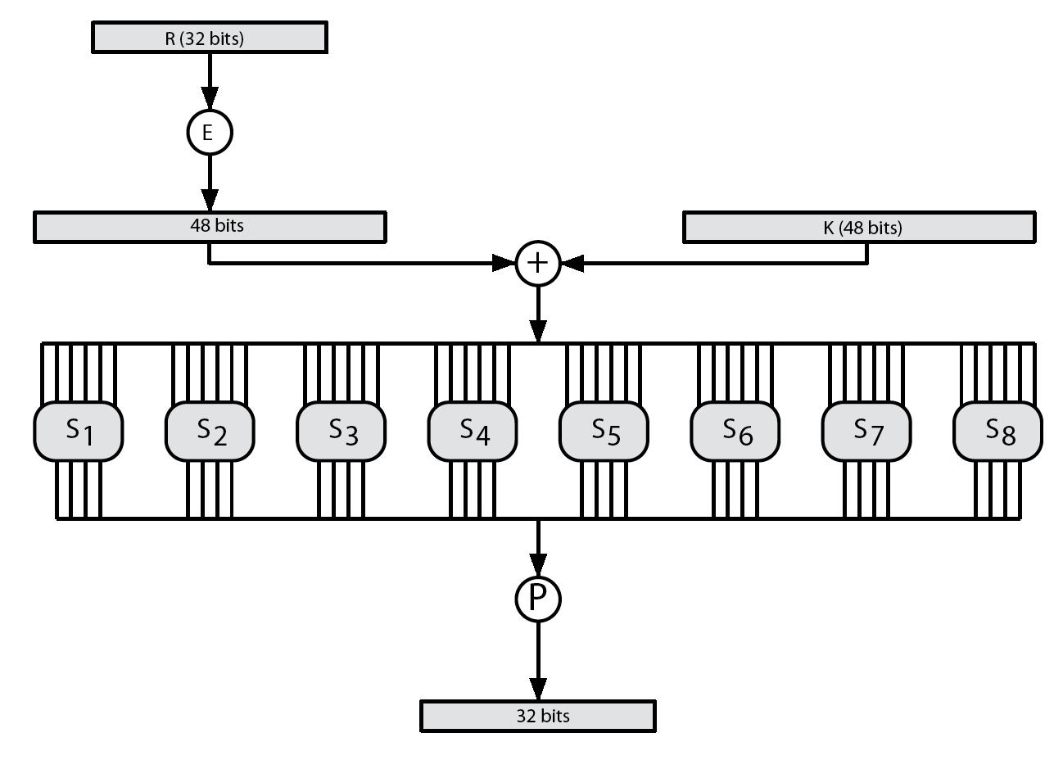
The function F(k_{i}, x)
S-box: function {0,1}⁶ ⟶ {0,1}⁴ , implemented as look-up table.
Notes:
E box: bit 1 → bit 2 and 48, bit 2 → bit 3
P Box: bit 1 → bit 9, bit 2 → bit 15

Slide 17
E-box
32 | 1 | 2 | 3 | 4 | 5
4 | 5 | 6 | 7 | 8 | 9
8 | 9 | 10 | 11 | 12 | 13
12 | 13 | 14 | 15 | 16 | 17
16 | 17 | 18 | 19 | 20 | 21
20 | 21 | 22 | 23 | 24 | 25
24 | 25 | 26 | 27 | 28 | 29
28 | 29 | 30 | 31 | 32 | 1
E: 表3

Slide 18
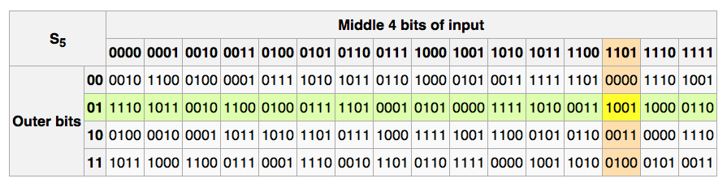
The S-boxes
S_{i}: {0,1}⁶ ⟶ {0,1}⁴

Slide 19
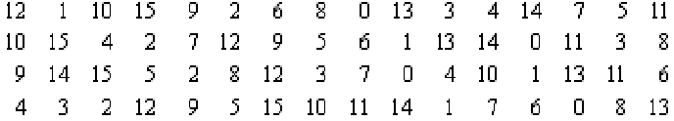

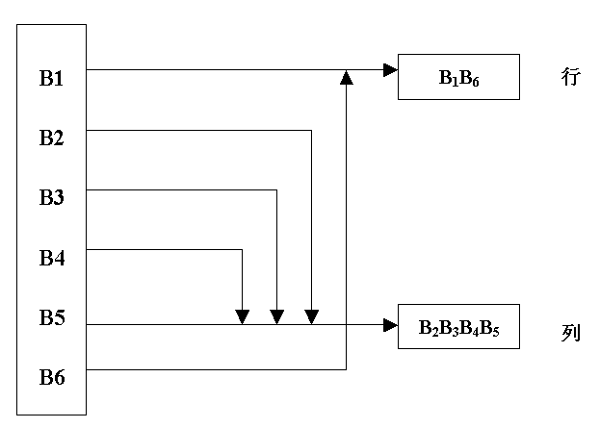
S-box example

Slide 20
All S-boxes
表4
表8
表5
表9
表6
表10
表7
表11

Slide 21
P-box
16 | 7 | 20 | 21 | 29 | 12 | 28 | 17
1 | 15 | 23 | 26 | 5 | 18 | 31 | 10
2 | 8 | 24 | 14 | 32 | 27 | 3 | 9
19 | 13 | 30 | 6 | 22 | 11 | 4 | 25
P: 表12

Slide 22
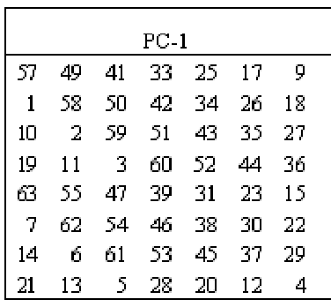
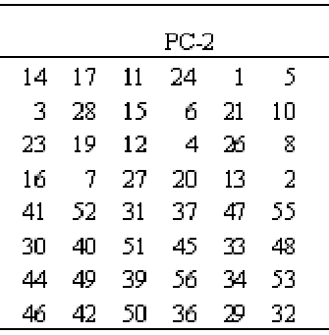
Round Key Generation
表15
表13
表14

Slide 23
Choosing the S-boxes and P-box
Choosing the S-boxes and P-box at random would result in an insecure block cipher
Several rules used in choice of S and P boxes:
No output bit should be close to a linear func. of the input bits
S-boxes are 4-to-1 maps, nonlinear
P-boxes: avalanche effect (雪崩效应) – one single bit change spreads to the whole block
⋮

Slide 24
DES动画演示
http://kathrynneugent.com/animation.html

Slide 25
DES分析
借助差分密码分析的思想
1993年Wiener给出一个密钥搜索机的详细设计方案，估计100万美元制造一台机器，搜索一个密钥平均大约花3.5小时。
1997年1月28日，RSA数据安全公司在RSA安全年会上，悬赏一万美金破译密钥长度为56比特的DES算法。
美国克罗拉多州的程序员Verser从1997年3月13日起，用了96天的时间，在Internet上数万名志愿者的协同工作下，于1997年6月17日用穷尽密钥搜索方法成功地找到了DES的密钥。
1998年7月17日，电子边境基金会EFF使用一台25万美元的电脑通过穷尽密钥搜索方法在56小时内破解了56比特DES。1999年的RSA会议期间，穷尽密钥搜索时间减少到不足24小时。

Slide 26
事件表明：依靠Internet分布式的计算能力，
用穷尽密钥搜索攻击方法
破译DES已成为可能。
1998年美国政府决定不再继续延用DES作为联邦加密标准，DES已走到了它生命的尽头，退出加密标准的舞台。
新的标准3DES、AES粉墨登场。

Slide 27
DES感悟
DES算法的颁布引起了学术界和企业界的广泛重视：
30多年来，DES已经在世界范围内成为事实上的加密标准，一直作为分组密码设计的标准参照物。
学术界对DES密码进行了深入的研究，围绕它的安全性和破译方法展开了激烈的争论，这在一定意义上对密码学的理论研究起了推动作用。
DES出色地顶住了年复一年、形形色色的密码分析，其精巧的设计至今仍闪烁着人类思想的精华，其结构和部件仍被后人效仿。

Slide 28
虽然DES没能长期地作为数据加密标准算法，但它仍是迄今为止得到最广泛应用的一种算法，也是一种最有代表性的分组加密算法。
详细地研究这一算法的基本原理、设计思想、安全性分析以及实际应用中的有关问题，对于掌握分组密码理论和当前的实际应用都很有意义。

Slide 29
习题
该习题同时是DES加密的具体实例。假设明文和密钥有相同的位模式，即：
用十六进制表示：0 1 2 3 4 5 6 7 8 9 A B C D E F
用二进制表示： 0000 0001 0010 0011 0100 0101 0110 0111
1000 1001 1010 1011 1100 1101 1110 1111
1）推导第一轮的子密钥K₁
2）推导L₀，R₀
3）扩展R₀求E[R₀]
4）计算A= E[R₀]^ K₁
5）把上题的48位结果分为6位的集合并求对应S盒代换的值
6）利用上题的结论求32位的结果B
7）应用置换求P(B)
8）计算R₁=P(B)^ L₀
9）写出密文

Slide 30
AES

Slide 31
The AES process
1997: NIST publishes request for proposal
1998: 15 submissions. Five claimed attacks.
1999: NIST chooses 5 finalists
2000: NIST chooses Rijndael as AES (designed in Belgium)
Key sizes: 128, 192, 256 bits. Block size: 128 bits

Slide 32
AES is a Substitution-Permutation network (not Feistel)
k₁
k₂
k_{n}
S₁
S₁
S₁
S₂
S₂
S₂
S₃
S₃
S₃
⋯
⨁
input
⨁
output
⨁
⋯
⋯
⋯
S₈
S₈
S₈
subs.
layer
perm.
layer
inversion

Slide 33
AES-128 schematic
10 rounds
4
ByteSub
ShiftRow
MixColumn
ByteSub
ShiftRow
MixColumn
ByteSub
ShiftRow
input
⋯
4
⨁
⨁
⨁
⨁
k₀
invertible
k₁
k₂
k₉
⨁
k₁₀
key
output
key expansion:
4
16 bytes
16 bytes ⟶176 bytes
4

Slide 34
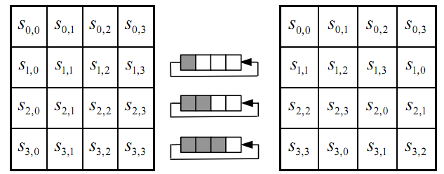
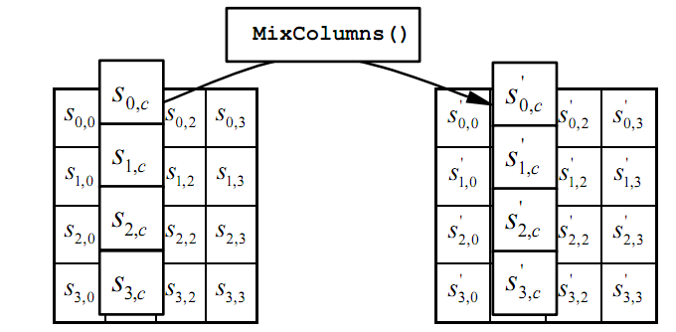
The round function
ByteSub: a 1 byte S-box. 256 byte table (easily computable)
ShiftRows:
MixColumns:
Notes:
S-box is easily computable with little code. All three steps can be combined and accelerated with pre-computed tables.

Slide 35
Code size/performance tradeoff
 | Code size | Performance
Pre-compute round functions (24KB or 4KB) | largest | fastest: table lookups and xors
Pre-compute S-box only (256 bytes) | smaller | slower
No pre-computation | smallest | slowest

Slide 36


Example: Javascript AES
AES in the browser:
AES library (6.4KB)
no pre-computed tables
Prior to encryption: pre-compute tables
Then encrypt using tables
http://crypto.stanford.edu/sjcl/
Notes:
http://crypto.stanford.edu/sjcl/

Slide 37
AES in hardware
AES instructions in Intel Westmere:
aesenc, aesenclast: do one round of AES
128-bit registers: xmm1=state, xmm2=round key
aesenc xmm1, xmm2 ; puts result in xmm1
aeskeygenassist: performs AES key expansion
Claim 14 x speed-up over OpenSSL on same hardware
Similar instructions on AMD Bulldozer
Notes:
To implement AES called aesenc 9 times and then call aesenclast.

Slide 38
How to use block cipher in practice

Slide 39
Modes of Operation
block ciphers encrypt fixed size blocks
eg. DES encrypts 64-bit blocks with 56-bit key
need some way to en/decrypt arbitrary amounts of data in practise
NIST SP 800-38A defines 5 modes, have block and stream modes
to cover a wide variety of applications
can be used with any block cipher
Notes:
DES (or any block cipher) forms a basic building block, which en/decrypts a fixed sized block of data. However to use these in practise, we usually need to handle arbitrary amounts of data, which may be available in advance (in which case a block mode is appropriate), and may only be available a bit/byte at a time (in which case a stream mode is used). To apply a block cipher in a variety of applications, five "modes of operation" have been defined by NIST (SP 800-38A). In essence, a mode of operation is a technique for enhancing the effect of a cryptographic algorithm or adapting the algorithm for an application, such as applying a block cipher to a sequence of data blocks or a data stream. The five modes are intended to cover a wide variety of applications of encryption for which a block cipher could be used. These modes are intended for use with any symmetric block cipher, including triple DES and AES. .

Slide 40
Electronic Codebook Book (ECB)
message is broken into independent blocks which are encrypted
each block is a value which is substituted, like a codebook, hence name
each block is encoded independently of the other blocks
C_{i} = E_{K}(P_{i})
uses: secure transmission of single values
Notes:
The simplest mode is the electronic codebook (ECB) mode, in which plaintext is handled one block at a time and each block of plaintext is encrypted using the same key. The term codebook is used because, for a given key, there is a unique ciphertext for every b-bit block of plaintext. Therefore, we can imagine a gigantic codebook in which there is an entry for every possible b-bit plaintext pattern showing its corresponding ciphertext. For a message longer than b bits, the procedure is simply to break the message into b-bit blocks, padding the last block if necessary. Decryption is performed one block at a time, always using the same key. ECB is the simplest of the modes, and is used when only a single block of info needs to be sent (eg. a session key encrypted using a master key).

Slide 41
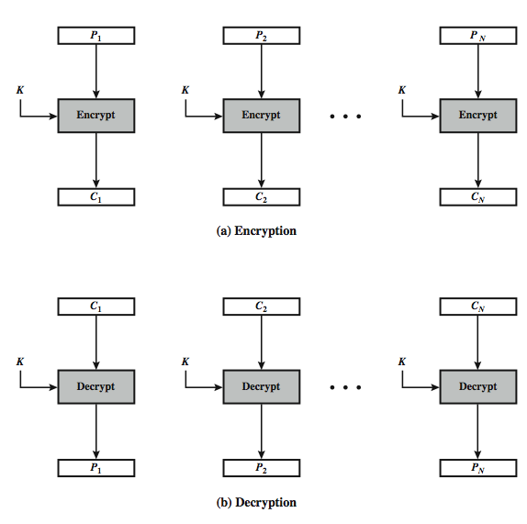
Electronic Codebook Book (ECB)
Notes:
Stallings Figure 6.3 illustrates the Electronic Codebook (ECB) Mode.

Slide 42
Advantages and Limitations of ECB
message repetitions may show in ciphertext
if aligned with message block
particularly with data such as graphics
or with messages that change very little, which become a code-book analysis problem
weakness is due to the encrypted message blocks being independent
main use is sending a few blocks of data
Notes:
For lengthy messages, the ECB mode may not be secure. If the message is highly structured, it may be possible for a cryptanalyst to exploit these regularities. If the message has repetitive elements, with a period of repetition a multiple of b bits, then these elements can be identified by the analyst. This may help in the analysis or may provide an opportunity for substituting or rearranging blocks. Hence ECB is not appropriate for any quantity of data, since repetitions can be seen, esp. with graphics, and because the blocks can be shuffled/inserted without affecting the en/decryption of each block. Its main use is to send one or a very few blocks, eg a session encryption key.

Slide 43
Cipher Block Chaining (CBC)
message is broken into blocks
linked together in encryption operation
each previous cipher blocks is chained with current plaintext block, hence name
use Initial Vector (IV) to start process
C_{i} = E_{K}(P_{i} XOR C_{i-1})
C₋₁ = IV
uses: bulk data encryption, authentication
Notes:
To overcome the problems of repetitions and order independence in ECB, want some way of making the ciphertext dependent on all blocks before it. The CBC provides this, by combining the previous ciphertext block with the current message block before encrypting. In effect, we have chained together the processing of the sequence of plaintext blocks. The input to the encryption function for each plaintext block bears no fixed relationship to the plaintext block. Therefore, repeating patterns of b bits are not exposed. For decryption, each cipher block is passed through the decryption algorithm. The result is XORed with the preceding ciphertext block to produce the plaintext block. To produce the first block of ciphertext, an initialization vector (IV) is XORed with the first block of plaintext. On decryption, the IV is XORed with the output of the decryption algorithm to recover the first block of plaintext. The IV is a data block that is that same size as the cipher block, and is either well known (often all 0's), or otherwise is sent, ECB encrypted, just before starting CBC use. CBC mode is applicable whenever large amounts of data need to be sent securely, provided that all data is available in advance (eg email, FTP, web etc).

Slide 44
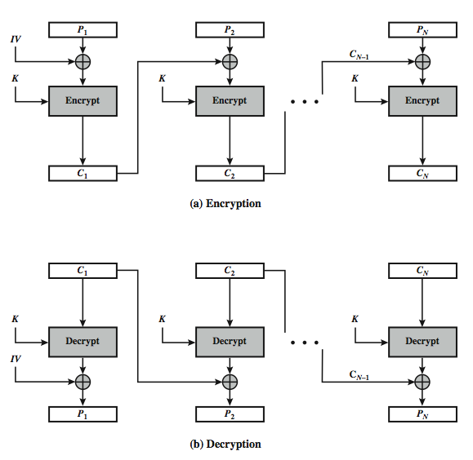
Cipher Block Chaining (CBC)
Notes:
Stallings Figure 6.4 illustrates the Cipher Block Chaining (CBC) Mode.

Slide 45
Message Padding
at end of message must handle a possible last short block
which is not as large as block-size of cipher
pad either with known non-data value (e.g. nulls)
or pad last block along with count of pad size
eg. [ b1 b2 b3 0 0 0 0 5]
means have 3 data bytes, then 5 bytes pad+count
this may require an extra entire block over those in message
there are other, more esoteric modes, which avoid the need for an extra block
Notes:
One issue that arises with block modes is how to handle the last block, which may well not be complete. In general have to pad this block (typically with 0's), and then must recognise padding at other end - may be obvious (eg in text the 0 value should usually not occur), or otherwise must explicitly have the last byte as a count of how much padding was used (including the count). Note that if this is done, if the last block IS an even multiple of 8 bytes or has exactly the same form as pad+count, then will have to add an extra block, all padding so as to have a count in the last byte. There are other, more esoteric, “ciphertext stealing” modes, which avoid the need for an extra block.

Slide 46
Advantages and Limitations of CBC
a ciphertext block depends on all blocks before it
any change to a block affects all following ciphertext blocks
need Initialization Vector (IV)
which must be known to sender & receiver
if sent in clear, attacker can change bits of first block, and change IV to compensate
hence IV must either be a fixed value (as in EFTPOS)
or must be sent encrypted in ECB mode before rest of message
Notes:
CBC is the block mode generally used. The chaining provides an avalanche effect, which means the encrypted message cannot be changed or rearranged without totally destroying the subsequent data. However there is the issue of ensuring that the IV is either fixed or sent encrypted in ECB mode to stop attacks on 1st block.

Slide 47
Stream Modes of Operation
block modes encrypt entire block
may need to operate on smaller units
real time data
convert block cipher into stream cipher
cipher feedback (CFB) mode
output feedback (OFB) mode
counter (CTR) mode
use block cipher as some form of pseudo-random number generator
Notes:
For AES, DES, or any block cipher, encryption is performed on a block of b bits. However, it is possible to convert a block cipher into a stream cipher, using one of the three modes to be discussed in this and the next two sections: cipher feedback (CFB) mode, output feedback (OFB) mode, and counter (CTR) mode. A stream cipher eliminates the need to pad a message to be an integral number of blocks. It also can operate in real time. Thus, if a character stream is being transmitted, each character can be encrypted and transmitted immediately using a character-oriented stream cipher. Idea here is to use the block cipher essentially as a pseudo-random number, and to combine these "random" bits with the message. One desirable property of a stream cipher is that the ciphertext be of the same length as the plaintext. Thus, if 8-bit characters are being transmitted, each character should be encrypted to produce a ciphertext output of 8 bits. If more than 8 bits are produced, transmission capacity is wasted.

Slide 48
Cipher FeedBack (CFB)
message is treated as a stream of bits
added to the output of the block cipher
result is feed back for next stage (hence name)
standard allows any number of bit (1,8, 64 or 128 etc) to be feed back
denoted CFB-1, CFB-8, CFB-64, CFB-128 etc
most efficient to use all bits in block (64 or 128)
C_{i} = P_{i} XOR E_{K}(C_{i-1})
C₋₁ = IV
uses: stream data encryption, authentication
Notes:
Cipher feedback (CFB) mode is one alternative. As with CBC, the units of plaintext are chained together, so that the ciphertext of any plaintext unit is a function of all the preceding plaintext. In this case, rather than units of b bits, the plaintext is divided into segments of s bits. The input to the encryption function is a b-bit shift register that is initially set to some initialization vector (IV). The leftmost (most significant) s bits of the output of the encryption function are XORed with the first segment of plaintext P1 to produce the first unit of ciphertext C1, which is then transmitted. In addition, the contents of the shift register are shifted left by s bits and C1 is placed in the rightmost (least significant) s bits of the shift register. This process continues until all plaintext units have been encrypted. For decryption, the same scheme is used, except that the received ciphertext unit is XORed with the output of the encryption function to produce the plaintext unit. Note that it is the encryption function that is used, not the decryption function.
As originally defined, CFB was to "consume" as much of the "random" output as needed for each message unit (bit/byte) before "bumping" bits out of the buffer and re-encrypting. This is wasteful though, and slows the encryption down as more encryptions are needed. An alternate way to think of it is to generate a block of "random" bits, consume them as message bits/bytes arrive, and when they're used up, only then feed a full block of ciphertext back. This is CFB-64 or CFB-128 mode (depending on the block size of the cipher used eg DES or AES respectively). CFB is the usual choice for quantities of stream oriented data, and for authentication use.

Slide 49
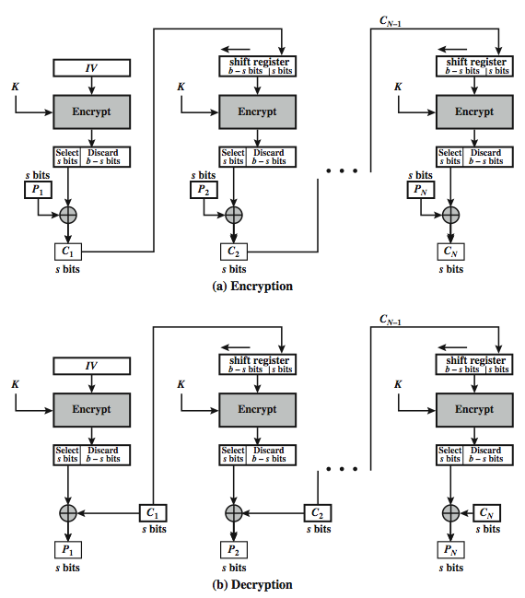
s-bit Cipher Feedback (CFB-s)
Notes:
Stallings Figure 6.5 illustrates the operation of s-bit Cipher FeedBack (CFB) Mode.

Slide 50
Advantages and Limitations of CFB
appropriate when data arrives in bits/bytes
most common stream mode
note that the block cipher is used in encryption mode at both ends
errors propagate for several blocks after the error
Notes:
CFB is the usual stream mode. As long as can keep up with the input, doing encryptions every 8 bytes. A possible problem is that if its used over a "noisy" link, then any corrupted bit will destroy values in the current and next blocks (since the current block feeds as input to create the random bits for the next). So either must use over a reliable network transport layer (typical) or use OFB/CTR.

Slide 51
Output FeedBack (OFB)
message is treated as a stream of bits
output of cipher is added to message
output is then feed back (hence name)
feedback is independent of message
can be computed in advance
O_{i} = E_{K}(O_{i-1})
C_{i} = P_{i} XOR O_{i}
O₋₁ = IV
uses: stream encryption on noisy channels
Notes:
An alternative to CFB is OFB. Here the generation of the "random" bits is independent of the message being encrypted. The output feedback (OFB) mode is similar in structure to that of CFB, except that the output of the encryption function is fed back to the shift register in OFB, whereas in CFB the ciphertext unit is fed back to the shift register. The other difference is that the OFB mode operates on full blocks of plaintext and ciphertext, not on an s-bit subset. The advantage is that firstly, they can be computed in advance, which is good for bursty traffic, and secondly, any bit error only affects a single bit. Thus this is good for noisy links (eg satellite TV transmissions etc).

Slide 52
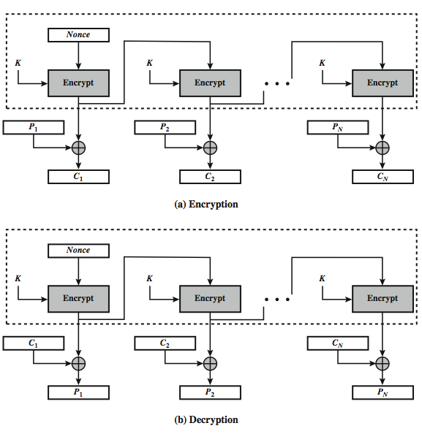
Output Feedback (OFB)
Notes:
Stallings Figure 6.6 illustrates the Output FeedBack (OFB) Mode.

Slide 53
Advantages and Limitations of OFB
needs an IV which is unique for each use
if ever reuse attacker can recover outputs
bit errors do not propagate
more vulnerable to message stream modification
sender & receiver must remain in sync
only use with full block feedback
subsequent research has shown that only full block feedback (ie CFB-64 or CFB-128) should ever be used
Notes:
As with CBC and CFB, the OFB mode requires an initialization vector. In the case of OFB, the IV must be a nonce; that is, the IV must be unique to each execution of the encryption operation. The reason for this is that the sequence of encryption output blocks, Oi. , depends only on the key and the IV, and does not depend on the plaintext. Therefore, for a given key and IV, the stream of output bits used to XOR with the stream of plaintext bits is fixed. If two different messages had an identical block of plaintext in the identical position, then an attacker would be able to determine that portion of the O stream.
One advantage of the OFB method is that bit errors in transmission do not propagate. The disadvantage of OFB is that it is more vulnerable to a message stream modification attack than is CFB.
OFB has the structure of a typical stream cipher, in that the cipher generates a stream of bits as a function of an initial value and a key, and that stream of bits is XORed with the plaintext bits. Hence the sender & receiver need to remain in sync, or all data is lost. Also, research has shown that you should only ever use a full block feedback ie OFB-64/128 mode. Hence OFB encrypts plaintext a full block at a time, where typically a block is 64 or 128 bits.

Slide 54
Counter (CTR)
a “new” mode, though proposed early on
similar to OFB but encrypts counter value rather than any feedback value
must have a different key & counter value for every plaintext block (never reused)
O_{i} = E_{K}(i)
C_{i} = P_{i} XOR O_{i}
uses: high-speed network encryptions
Notes:
The Counter (CTR) mode is a variant of OFB, but which encrypts a counter value (hence name). Although it was proposed many years before, it has only recently been standardized for use with AES along with the other existing 4 modes. It is being used with applications in ATM (asynchronous transfer mode) network security and IPSec (IP security). A counter, equal to the plaintext block size is used. The only requirement stated in SP 800-38A is that the counter value must be different for each plaintext block that is encrypted. Typically the counter is initialized to some value and then incremented by 1 for each subsequent block. As with the OFB mode, the initial counter value must be a nonce; be different for all of the messages encrypted using the same key. Further, all counter values across all messages must be unique. If, contrary to this requirement, a counter value is used multiple times, then the confidentiality of all of the plaintext blocks corresponding to that counter value may be compromised.

Slide 55
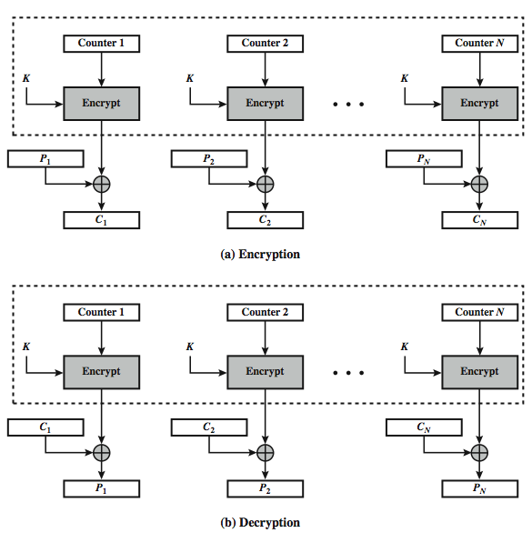
Counter (CTR)
Notes:
Stallings Figure 6.7 illustrates the Counter (CTR) Mode.

Slide 56
Advantages and Limitations of CTR
efficiency
can do parallel encryptions in h/w or s/w
can preprocess in advance of need
good for bursty high speed links
random access to encrypted data blocks
provable security (good as other modes)
but must ensure never reuse key/counter values, otherwise could break (cf OFB)
Notes:
CTR mode has a number of advantages in parallel h/w & s/w efficiency, can preprocess the output values in advance of needing to encrypt, can get random access to encrypted data blocks, and is simple. But like OFB have issue of not reusing the same key+counter value.

Slide 57
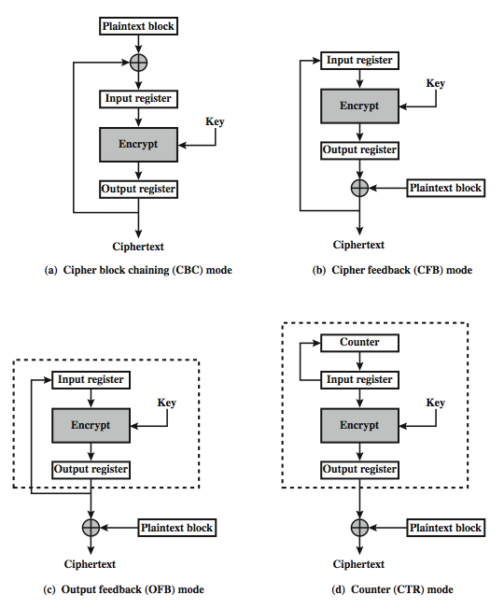
Feedback Characteristics
Notes:
Note that, with the exception of ECB, all of the NIST-approved block cipher modes of operation involve feedback. This is clearly seen in Stallings Figure 6.8. To highlight the feedback mechanism, it is useful to think of the encryption function as taking input from a input register whose length equals the encryption block length and with output stored in an output register. The input register is updated one block at a time by the feedback mechanism. After each update, the encryption algorithm is executed, producing a result in the output register. Meanwhile, a block of plaintext is accessed. Note that both OFB and CTR produce output that is independent of both the plaintext and the ciphertext. Thus, they are natural candidates for stream ciphers that encrypt plaintext by XOR one full block at a time.

Slide 58
Take-home Information
Block cipher design model: Feistel network, Substitution-Permutation network
DES
AES
Block cipher are used in various modes to encrypt real-world data.
Notes:
Chapter 7 summary.

